Slide 1
Working with Google Applications
Notes:
slides 10-15 - 15 minutes Google applications or apps are free programs that you can use once you have established a google account. These programs can be used on your chromebook, a computer, or your smartphone.

Slide 2
What is a Google Account and
why do I need one?
Allows use of free Google applications - examples below
Google Drive for storage
Free Google “apps” to create documents, spreadsheets, and presentations
Separate gmail (email) account for school-related activities
Experience the Google apps your children are using at school.
*Click on the below link for directions on
How to Create a Google Account

Slide 3
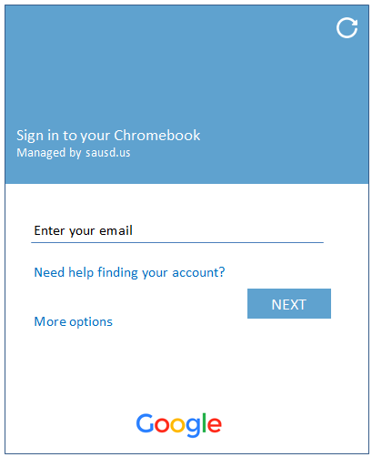
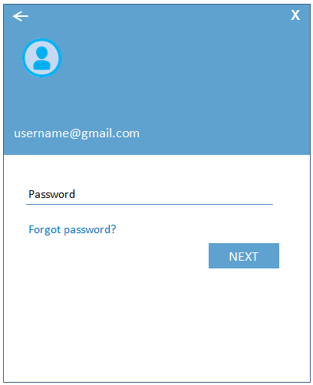
Log into the Chromebook
using the test account provided
Enter your Gmail username & Password provided on your handout.
Enter Gmail Username
& select Next
Enter Password
& select Next
Enter your Gmail
Username Only
Enter your Password
Notes:
Here is where we will have parents turn on the chromebook and now login. This screen is only for the day of the Digital Citizenship Academy. Parents will log in using the test student accounts provided.

Slide 4
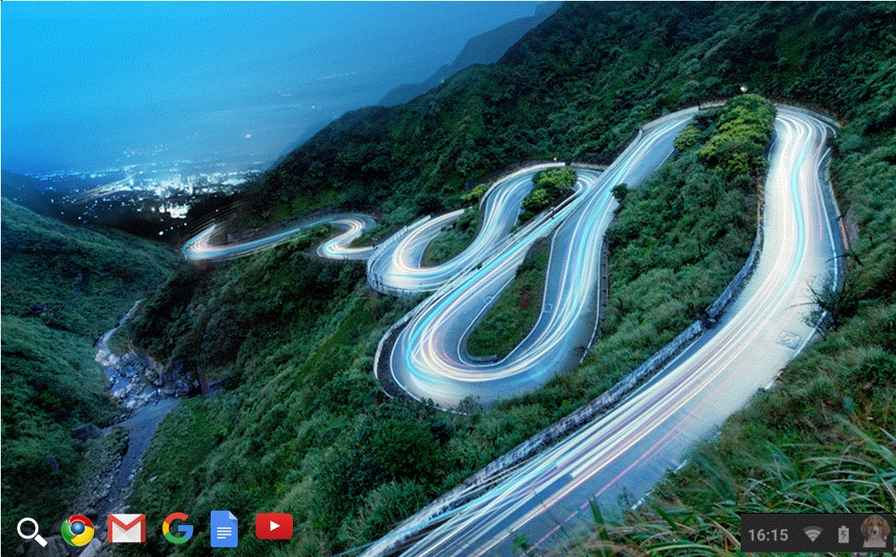
Screen After Logging In
Hold your mouse cursor over each of the icons above to identify where they lead - don’t click!
Notes:
Have the users hover mouse cursor over Google Chrome, Gmail, Google Docs, Youtube – don’t click!
Have users go back to Google and click

Slide 5
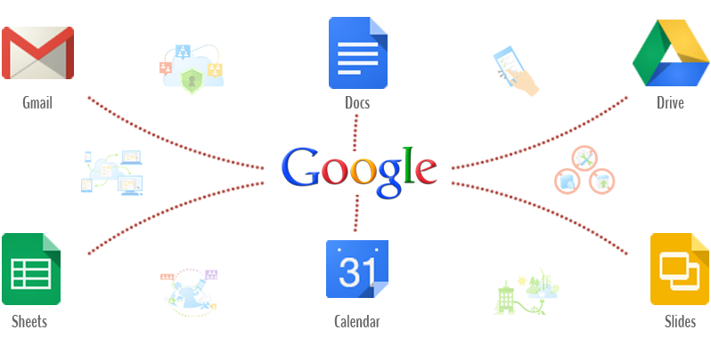
Google Apps
Notes:
What could we do with these apps?

Slide 6
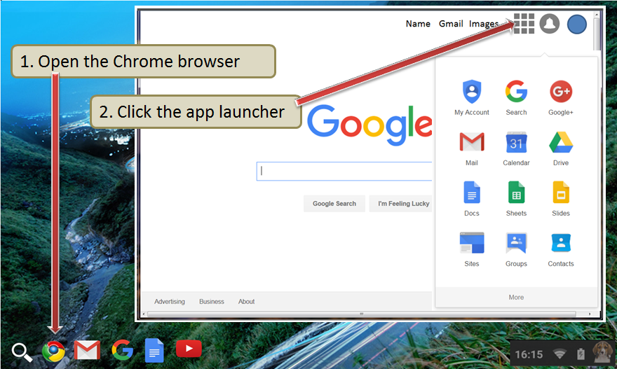
Google Apps Launcher
Notes:
Briefly talk about apps –have the users click on the Google icon and then click on apps icon in the top right corner. Emphasize Gmail, Drive, Translate, Calendar, maps.
Click on gmail icon

Slide 7
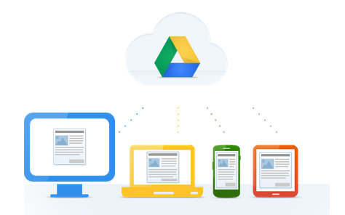
What is Google Drive?
Click on the link below to watch a video.
Google Drive: One Safe Place for all your stuff (English video)
Video Overview - Click to watch
Google Drive: Un lugar para todos tus documentos (en Español)
Haga un clic aquí para ver el video
Notes:
They can click on the English or Spanish video link that explains Google Drive. (video is 1:05 minutes))

Slide 8
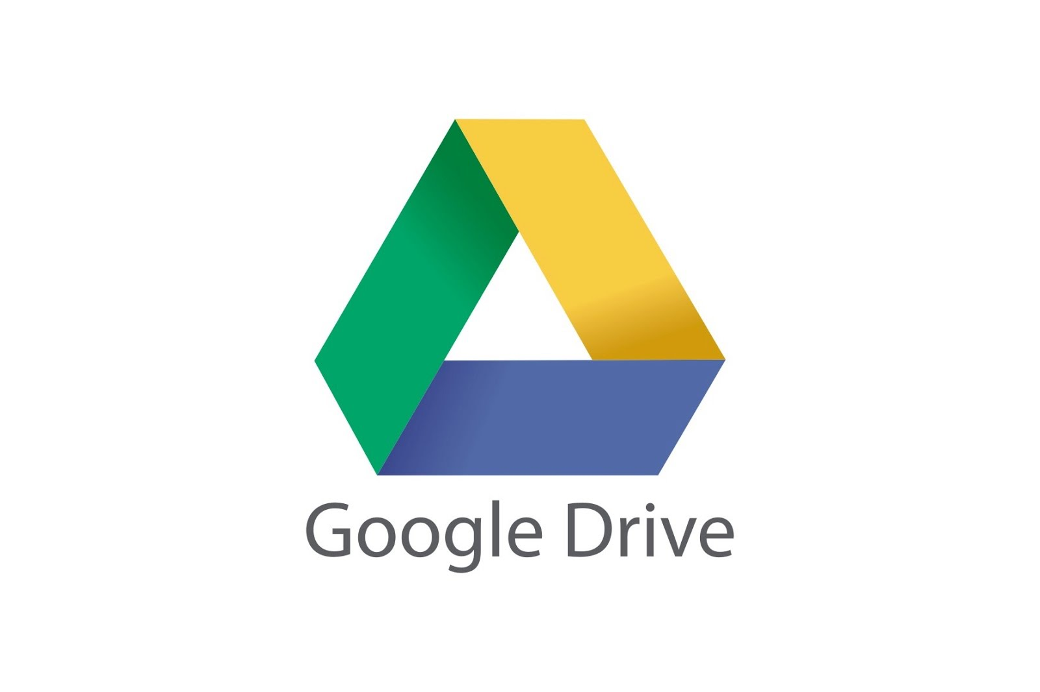
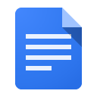
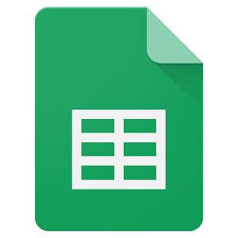
Popular Apps in Google Drive
What is Google Drive?
A place to store, create, view and share your documents.
What is Google Docs?
Create letters, resumes, essays, etc. in Google Docs.
What is Google Sheets?
Create budgets, invoices, schedules, or track your expenses
using Google Sheets as a few examples.
What are the benefits of using these apps?
Google Docs and Sheets already have sample templates
created to help you get started.
Everything you do in these apps is automatically saved.
There are even more apps!

Slide 9
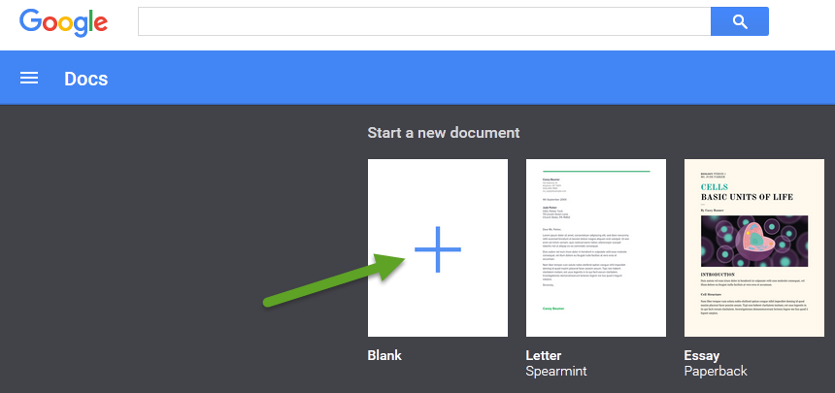
Google Docs
Click on the blank document to start a new one.
Notes:
Users can either click on the blank document or scroll through the sample documents provided.

Slide 10
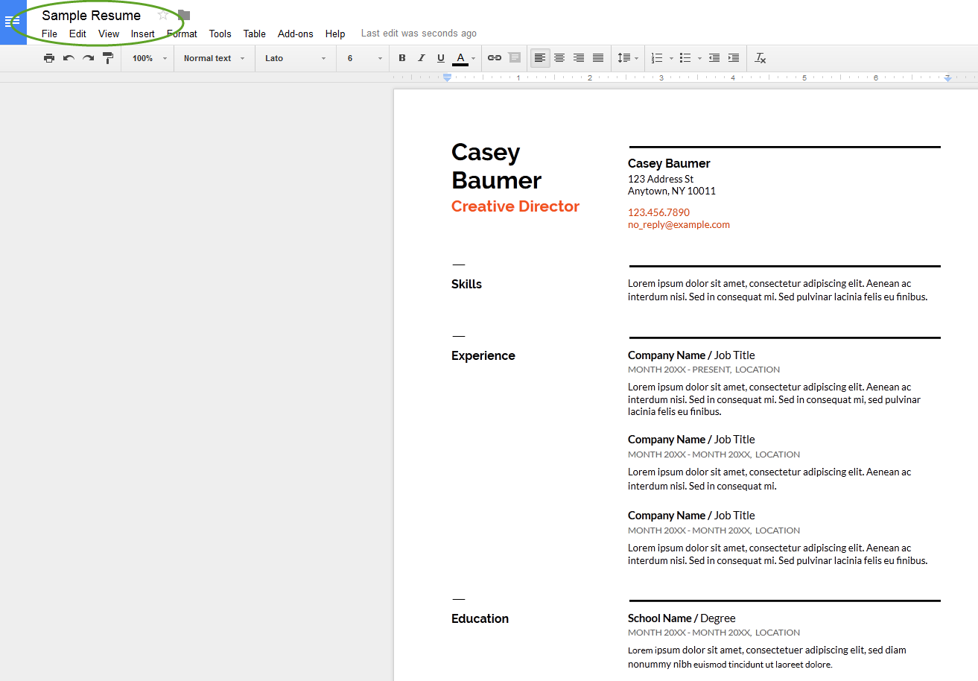
Google Docs
Use Google Docs to write a letter, create a resume, type an essay, etc.
Below is a sample resume created in Google Docs.

Slide 11
Google Sheets
Click in the blank sheet in order to start a new spreadsheet.

Slide 12
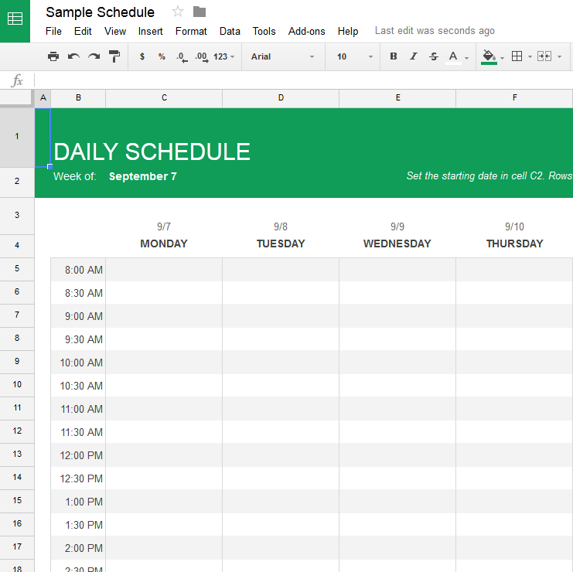
Google Sheets
Use Google Sheets in order to create a schedule, to-do list, budget, keep track of expenses, or create an invoice. Below is a sample of a schedule.

Slide 13
Notes:
End of class 1. Ask if there are any questions or comments.

